Slide 1
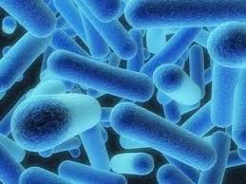
Diseases of Senegal
By: Fallon Dickinson
A1

Slide 2
Senegal is a country located in West Africa. It is a beautiful country but even it has diseases you should look out for. You must be prepared to become in contact with many different diseases.

Slide 3
The 3 Common Diseases
Yellow Fever
Hepatitis B
Rabies

Slide 4
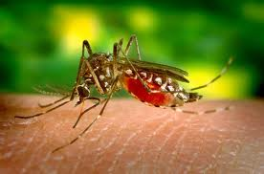
Yellow Fever
Yellow Fever is a one strand RNA virus.
Most travelers get this disease in common areas such as airports or by different insect bites.
Requirements:
Vaccine

Slide 5
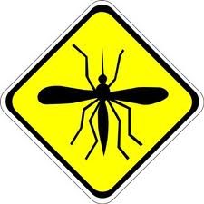
Risks
Risks:
The biggest factor to the risks of Yellow Fever
Where it is you are traveling
Insect bites
What season you will be there

Slide 6
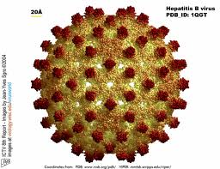
Hepatitis B
Hepatitis B is a small, circular, partially double-stranded DNA virus.
Is commonly caught when blood is transmitted through two people’s blood
Sexual activity
Tattooing
Dental and Clinic Care

Slide 7
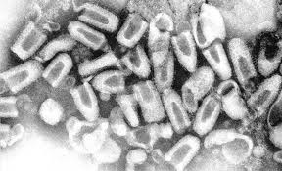
Rabies
Normally exposed to rabies when bitten by an animal with rabies (saliva of animals)
This illness attacks the brain and does not effect the blood
Takes control of nervous system(Rabies)

Slide 8
How to get treated
Normally to get treated for Rabies you need to go to the doctor and get many different shots in the stomach.
When you get the shots the vaccine goes to your nerves and brain to stop the virus. (Rabies)

Slide 9
Works Cited
Rabies. (n.d.). Retrieved 2 22, 2013, from CDC Center of Diseases Control: http://wwwnc.cdc.gov/travel/yellowbook/2012/chapter-3-infectious-diseases-related-to-travel/rabies.htm
Rabies. (n.d.). Retrieved 2 22, 2013, from CDC Center of Diseases Control: http://wwwnc.cdc.gov/travel/yellowbook/2012/chapter-3-infectious-diseases-related-to-travel/rabies.htm
(CDC)
CDC. (n.d.). Retrieved 2 22, 2013, from CDC Center of Disease Control.
Rabies. (n.d.). Retrieved 2 22, 2013, from CDC Center of Diseases Control: http://wwwnc.cdc.gov/travel/yellowbook/2012/chapter-3-infectious-diseases-related-to-travel/rabies.htm
CDC. (n.d.). Retrieved 2 22, 2013, from CDC Center of Disease Control.
Rabies. (n.d.). Retrieved 2 22, 2013, from CDC Center of Diseases Control: http://wwwnc.cdc.gov/travel/yellowbook/2012/chapter-3-infectious-diseases-related-to-travel/rabies.htm

Slide 10
Images Citation
senegal. N.d. urbanyouthforafrica.orgWeb. 22 Feb 2013. <http://urbanyouthforafrica.org/senegal/>.
Communicable Disease Control . N.d. Bergan County Departmant of Health ServicesWeb. 22 Feb 2013.
Philadelphia Under Siege: The Yellow Fever of 1793. N.d. pabook.libraries.psu.eduWeb. 22 Feb 2013. <http://pabook.libraries.psu.edu/palitmap/YellowFever.html>.
Penn Manor Medical Centre. N.d. www.pennmanor.infoWeb. 22 Feb 2013. <http://www.pennmanor.info/?q=node/126>.
Hepititis B. ppt. N.d. freemadicalpower.blogspot.deWeb. 22 Feb 2013. <http://freemedicalpowerpoint.blogspot.de/2012/01/hepatitis-b.html>.

